Slide 1

TITLE OF THE PROJECT
TOIL SERVICES
FINAL WEB DEVELOPMENT
REPORT
by
GROUP-1
NAME OF CANDIDATES
NAME: ANURAG MISHRA-11708395
NAME: ABHISHEK HATWAR-11716550
NAME: ASHUTOSH KHAJURIA-11712194
NAME: AMAN SRIVASTAVA-11715962
Section: K17MD

Slide 2
Features of my Toil Services website :
Project Description:
A beautiful and motivative user interface
Information about the site.
Registration form for users.
The Project Toil.com is a website which deals with the problems faced by every common man.
The website deals with many servicing avenues such as Pluming, Carpentry, Electric, Pest control, House Projects etc.

Slide 3
Work Division:
Candidate 1: ANURAG MISHRA
Designing of user interface
Creation of whole home page
Header-footer for all the pages
A Tutor page where user can view detailed of video lectures.
Candidate 3: ABHISHEK HATWAR
Designing of user interface
Creation of registering page at enrollment side.
Candidate 2: ASHUTOSH KHAJURIA
Mind behind the toil services, planning that how website will work and how UI will look like moreover how backend of the site will be like for further development.
Designing idea of all pages.
Creation of service request page .
Creation of login/sign up page of enrolment side.
Candidate 4: AMAN SRIVASTAV
Designing of user interface
Creation of whole home page of enrollment side.

Slide 4
Technologies Used:
Generally five types of technologies are used-
Hypertext Mark-up language [HTML]
Cascading Style Sheets [CSS]
JavaScript [ JS]
Angularjs
Bootstrap

Slide 5
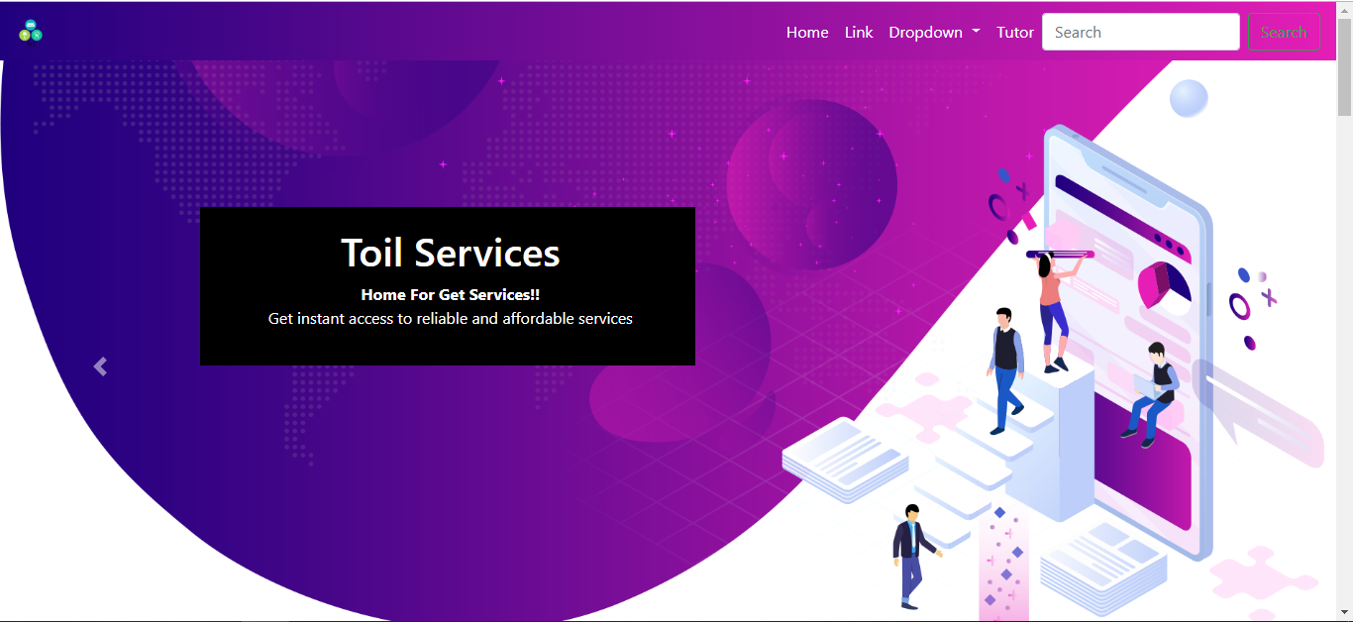
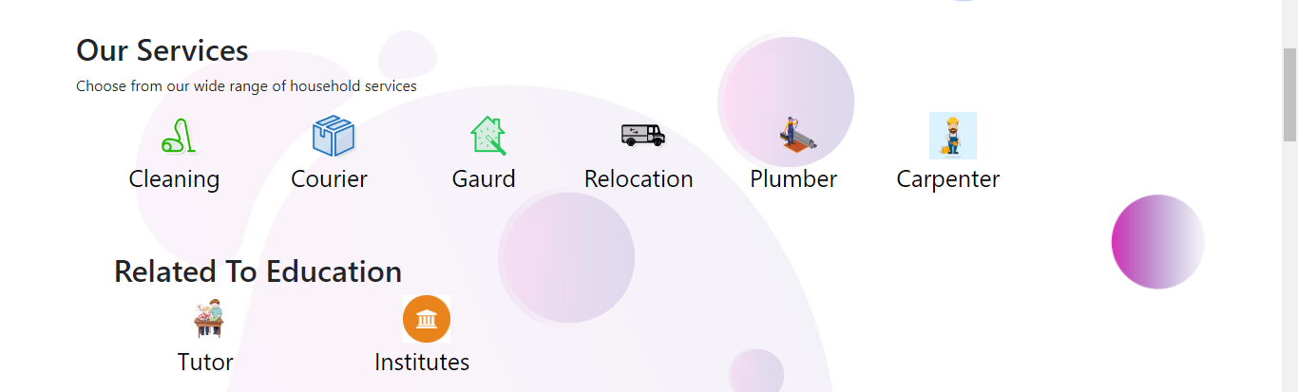
Candidate 1 Anurag Mishra-

Slide 6
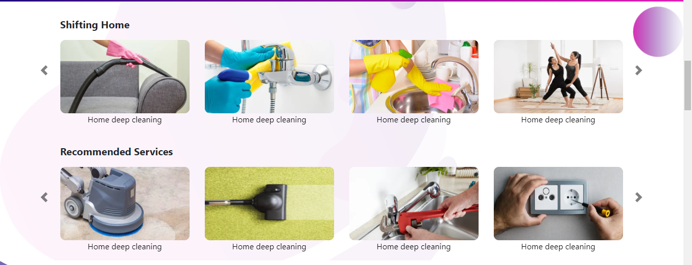
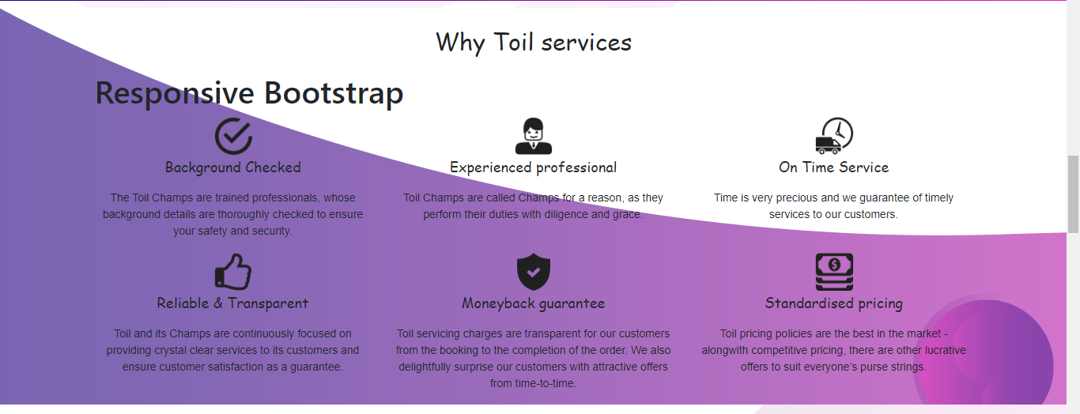
CANDIDATE 1-ANURAG

Slide 7

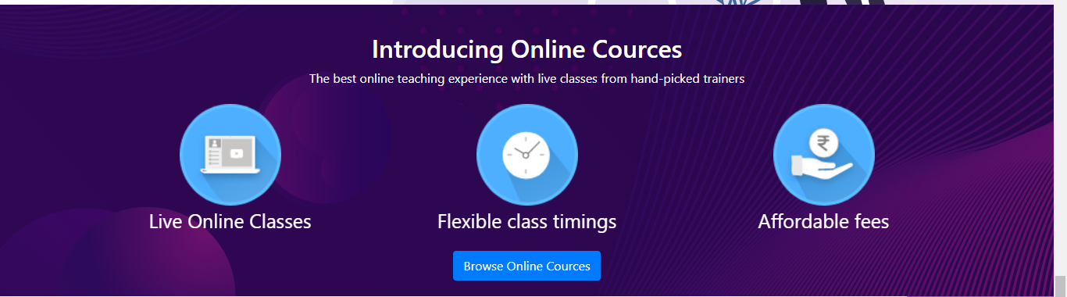
Home Page Details

Slide 8
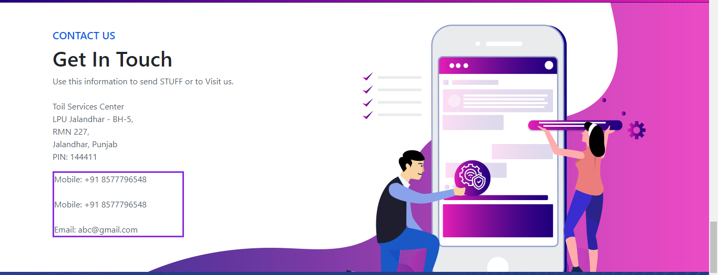
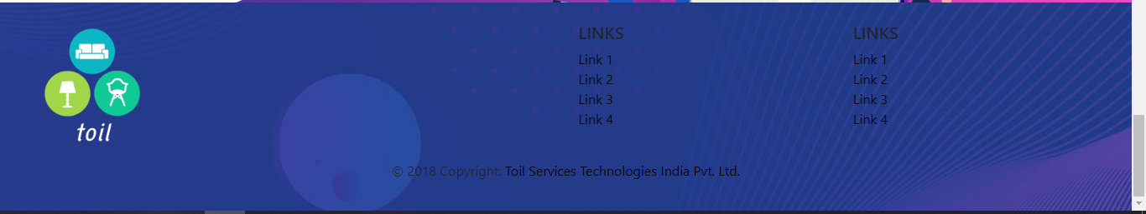
Get In Touch:
Footer:

Slide 9
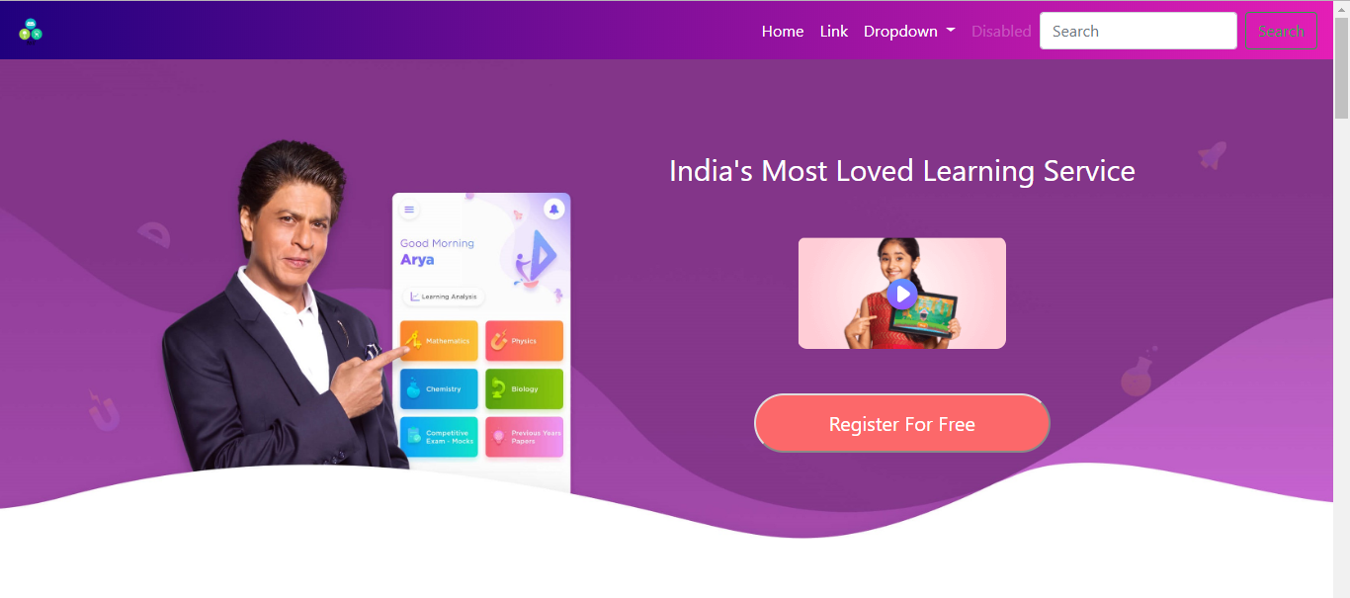
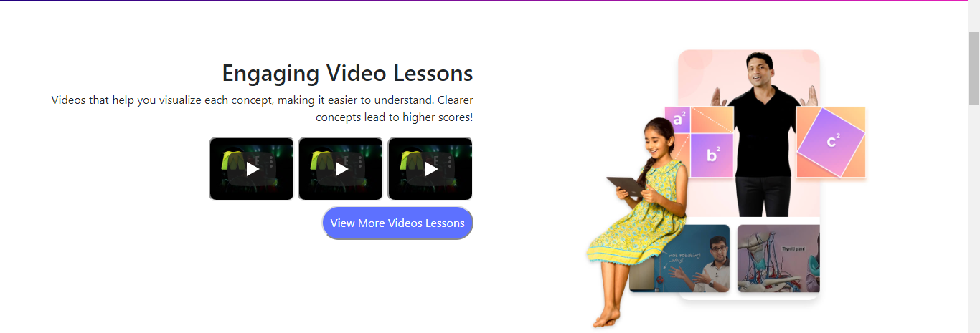
Education Hub

Slide 10
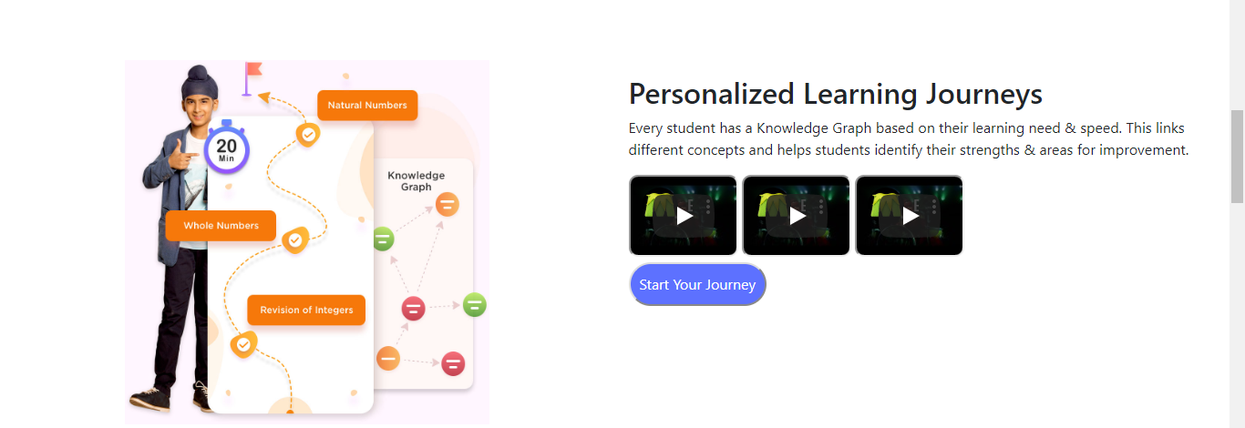
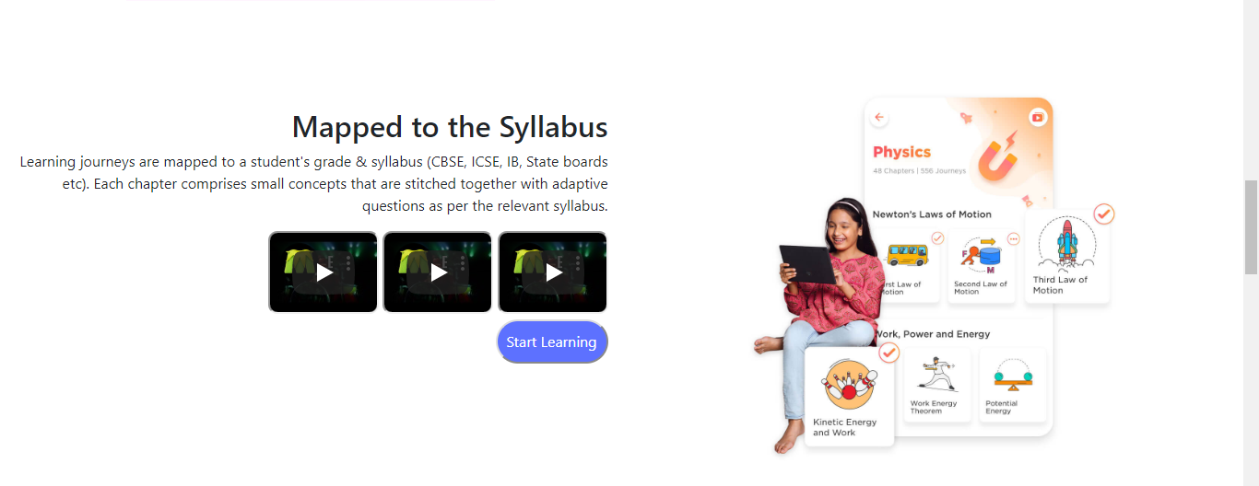

Slide 11
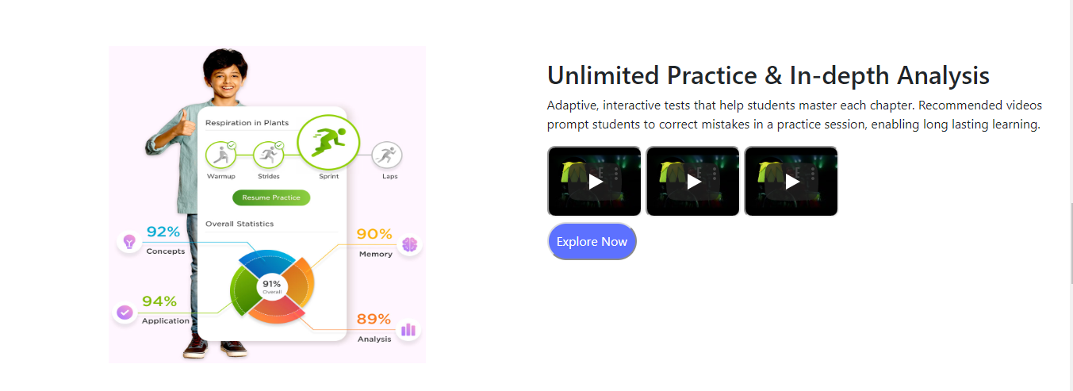
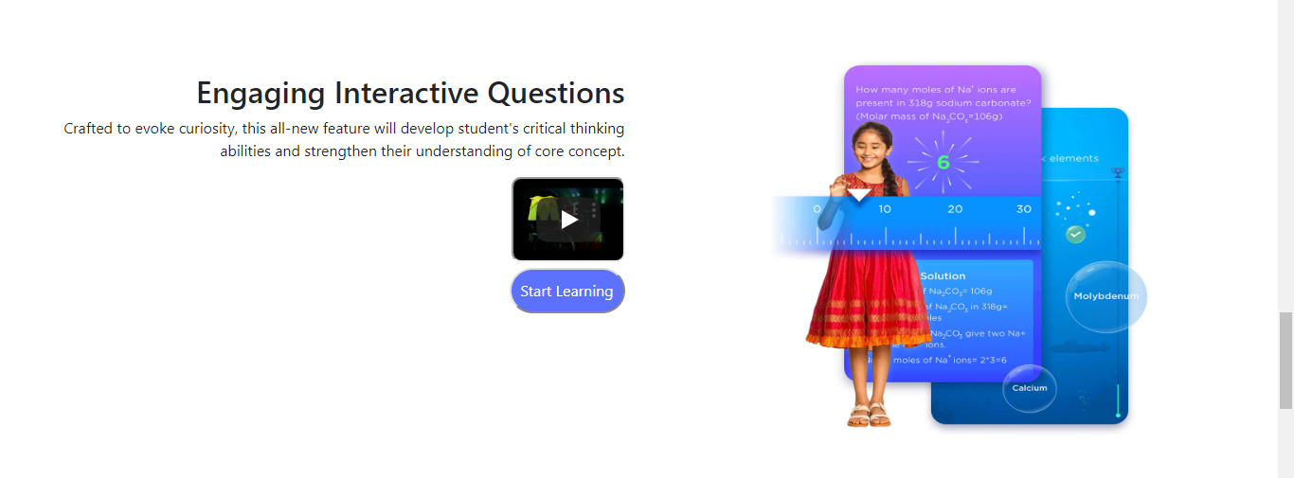

Slide 12
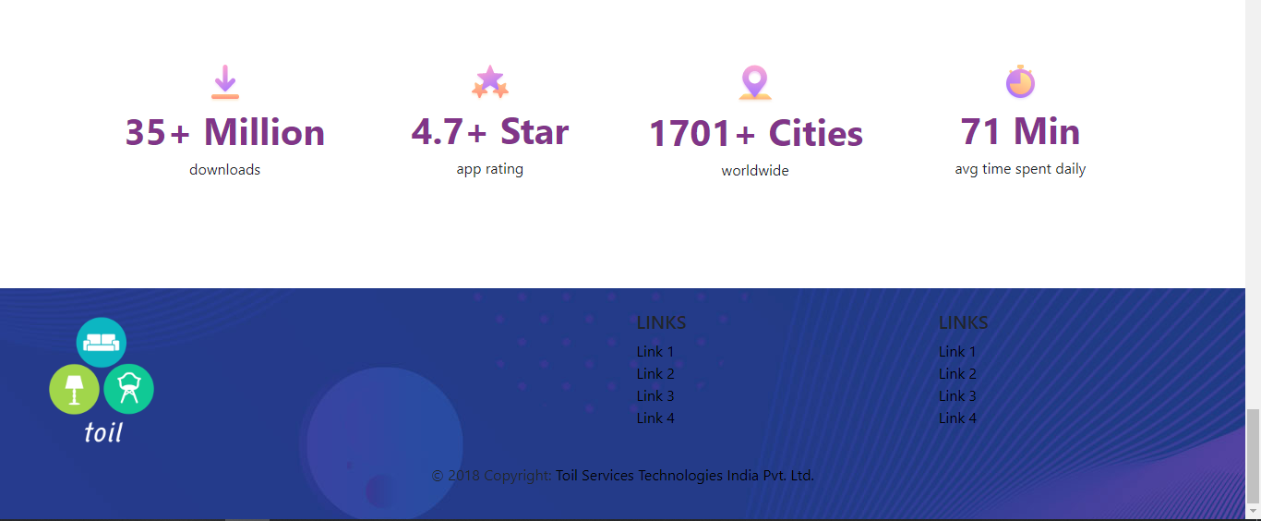

Slide 13
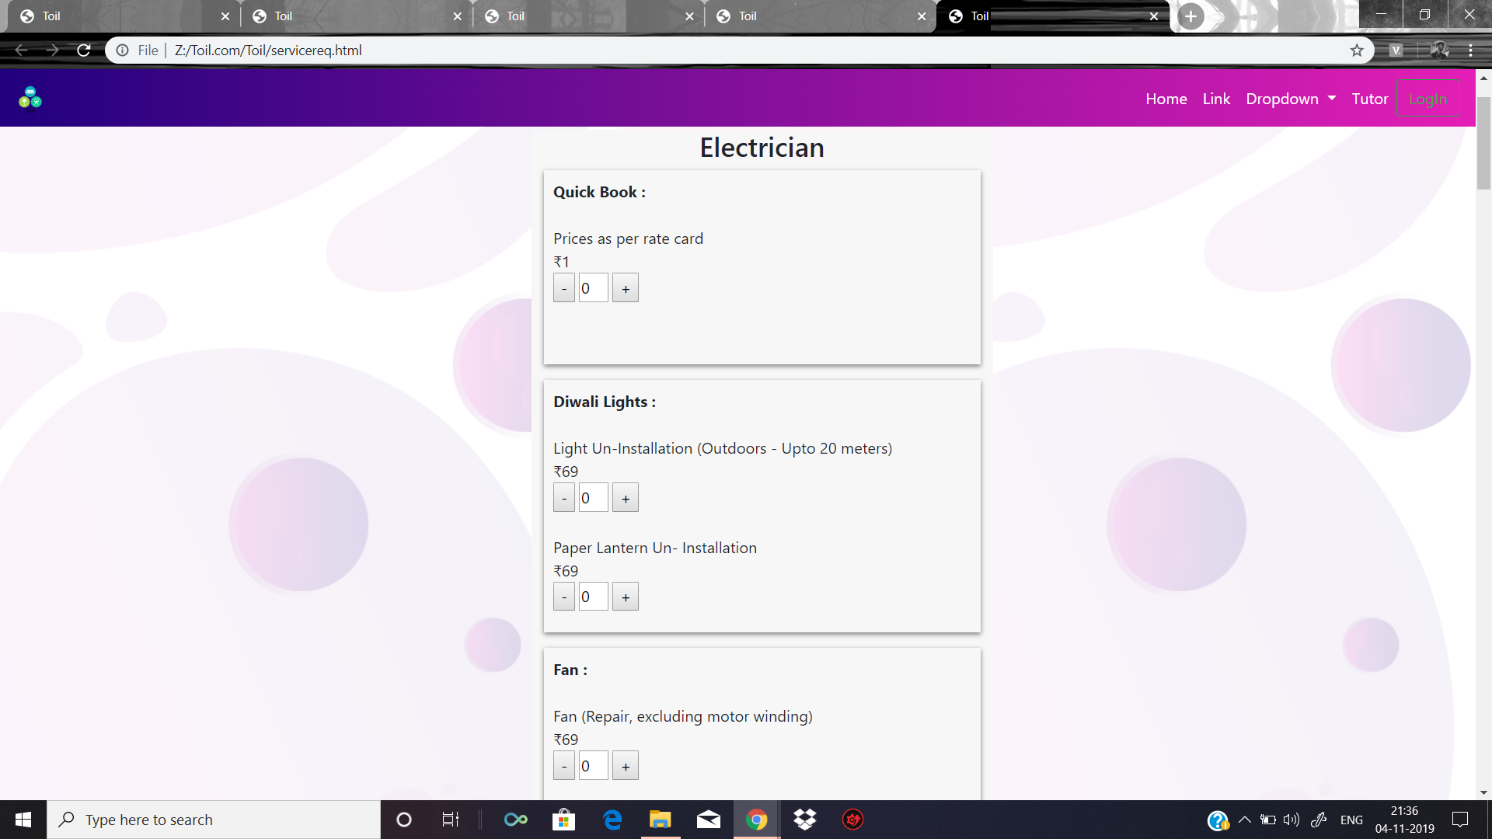
CANDIDATE 2- Ashutosh Khajuria

Slide 14
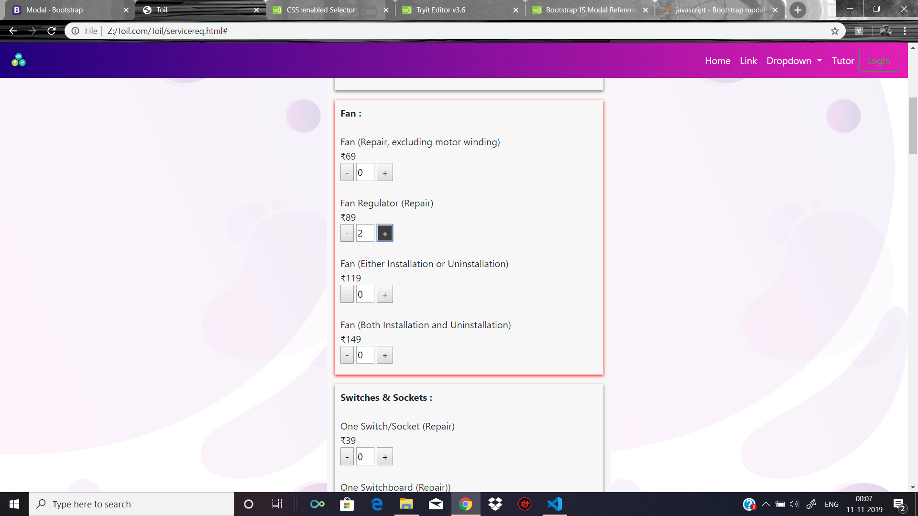
Service Request page

Slide 15
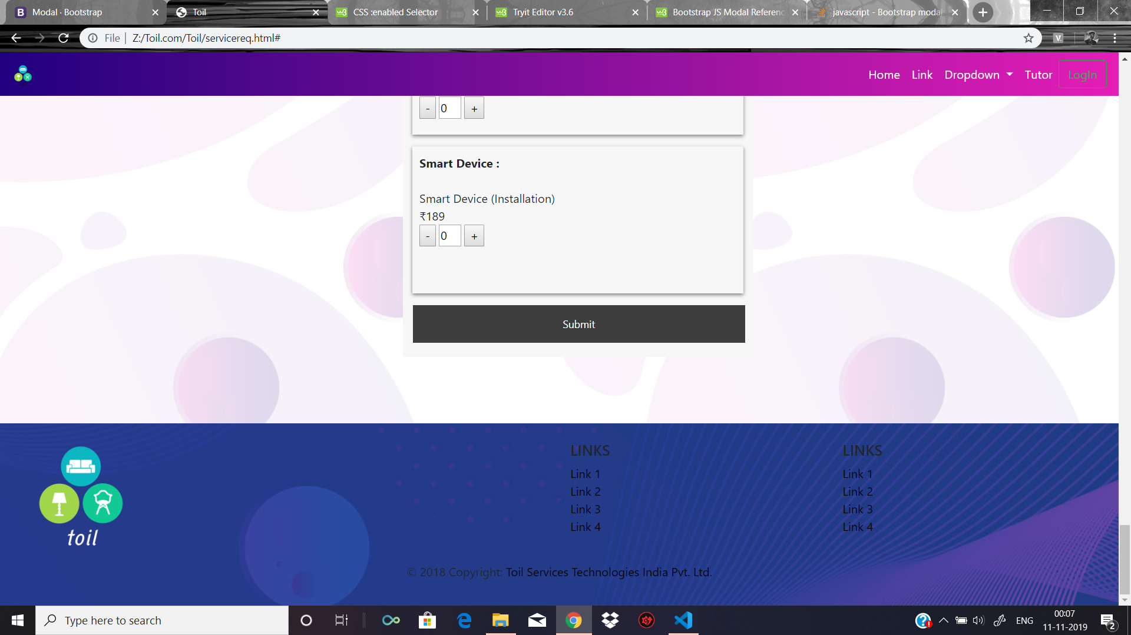

Slide 16
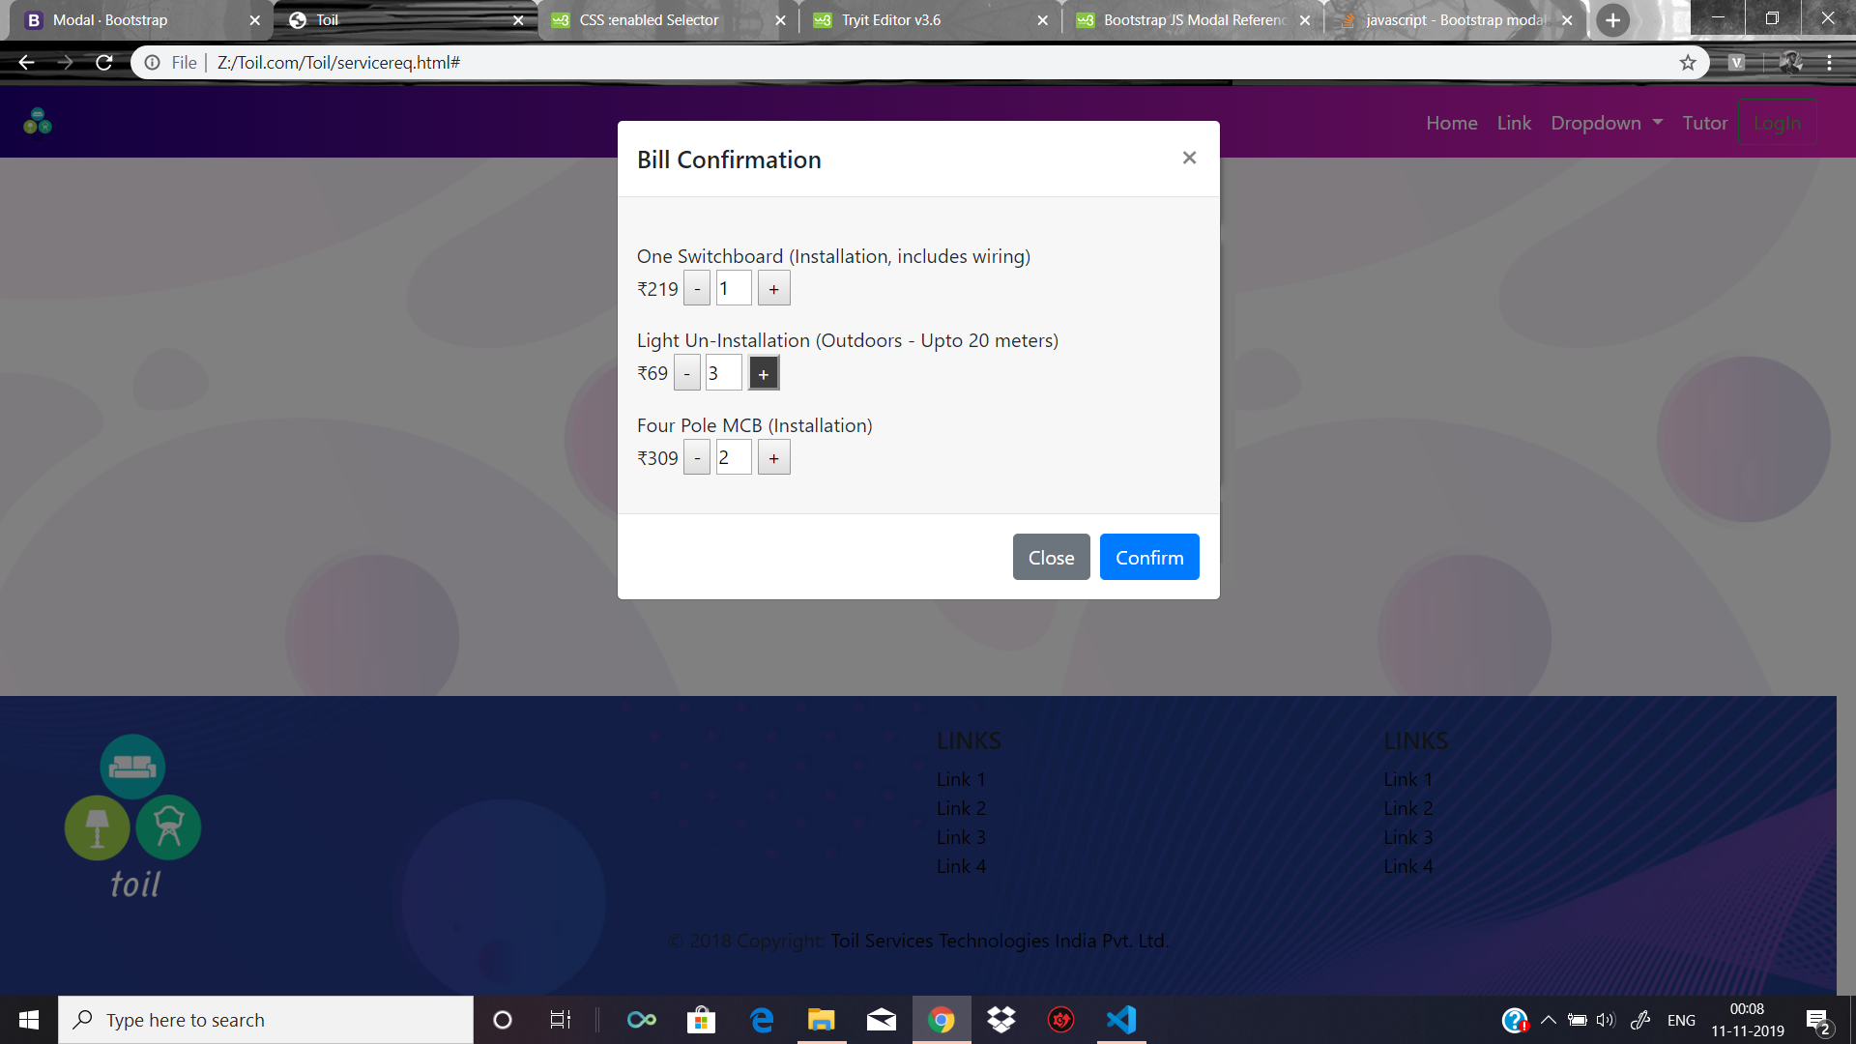

Slide 17
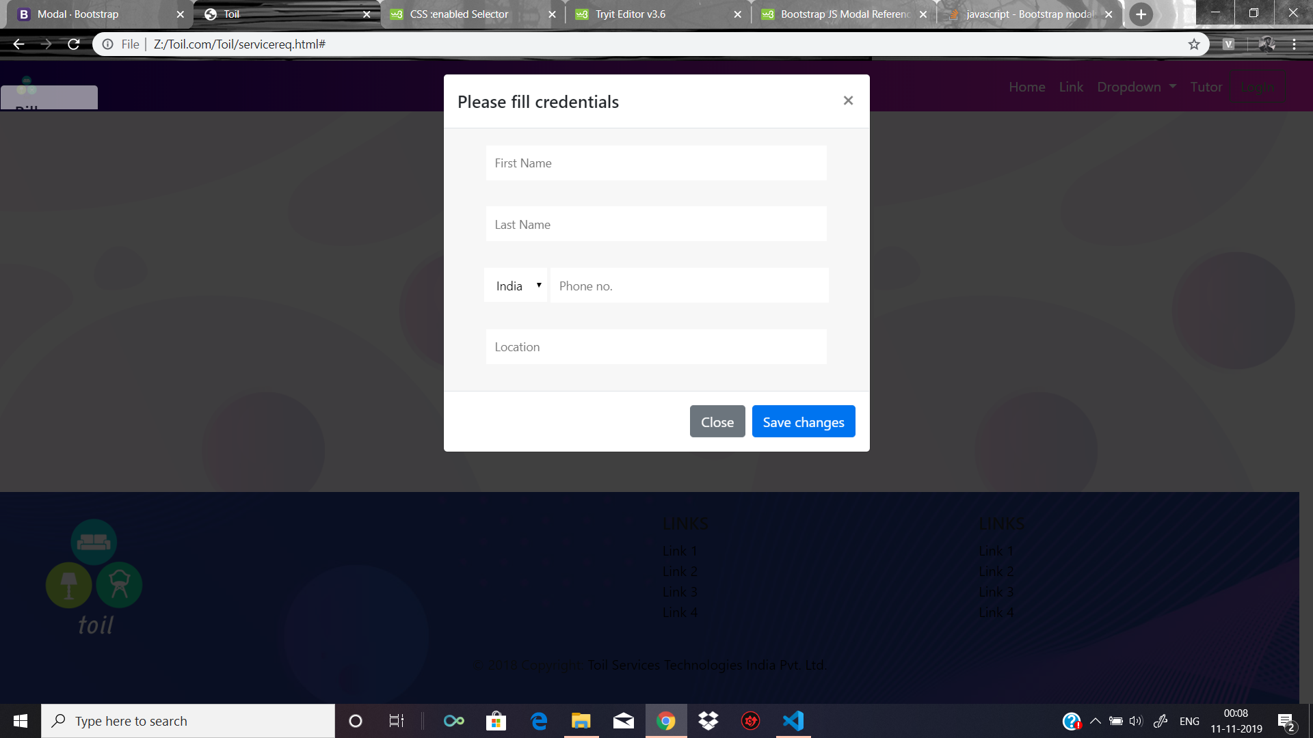

Slide 18
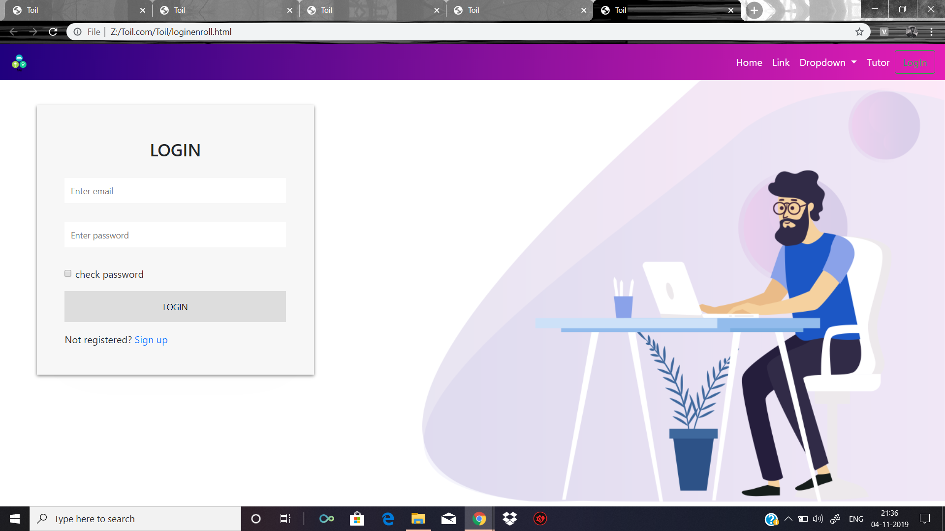
Login and Signup Page for Enrolment side

Slide 19
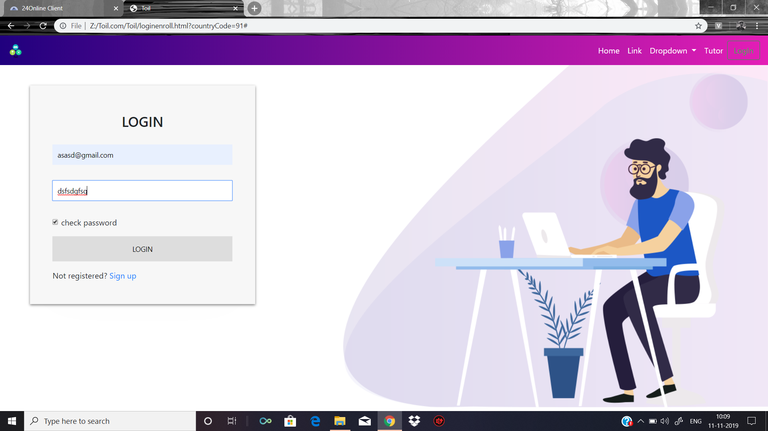

Slide 20
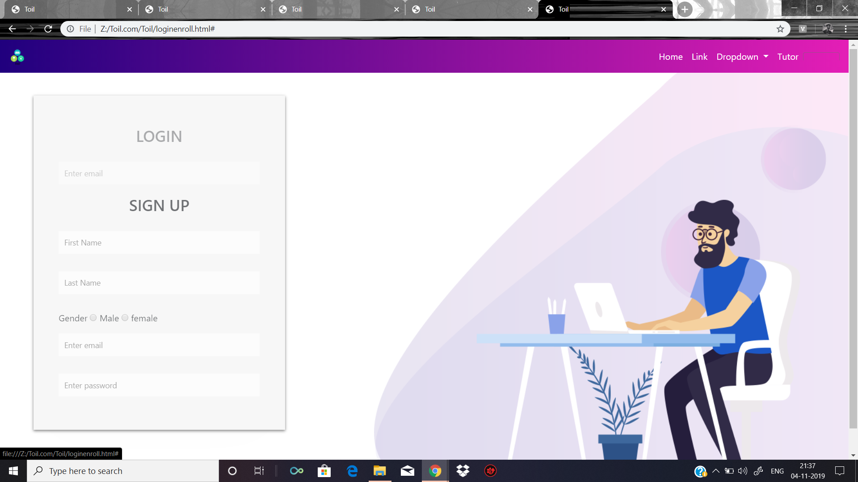

Slide 21
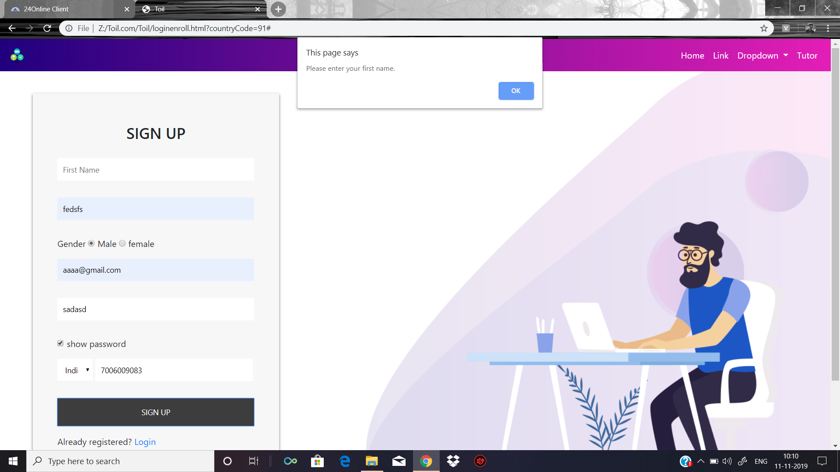

Slide 23
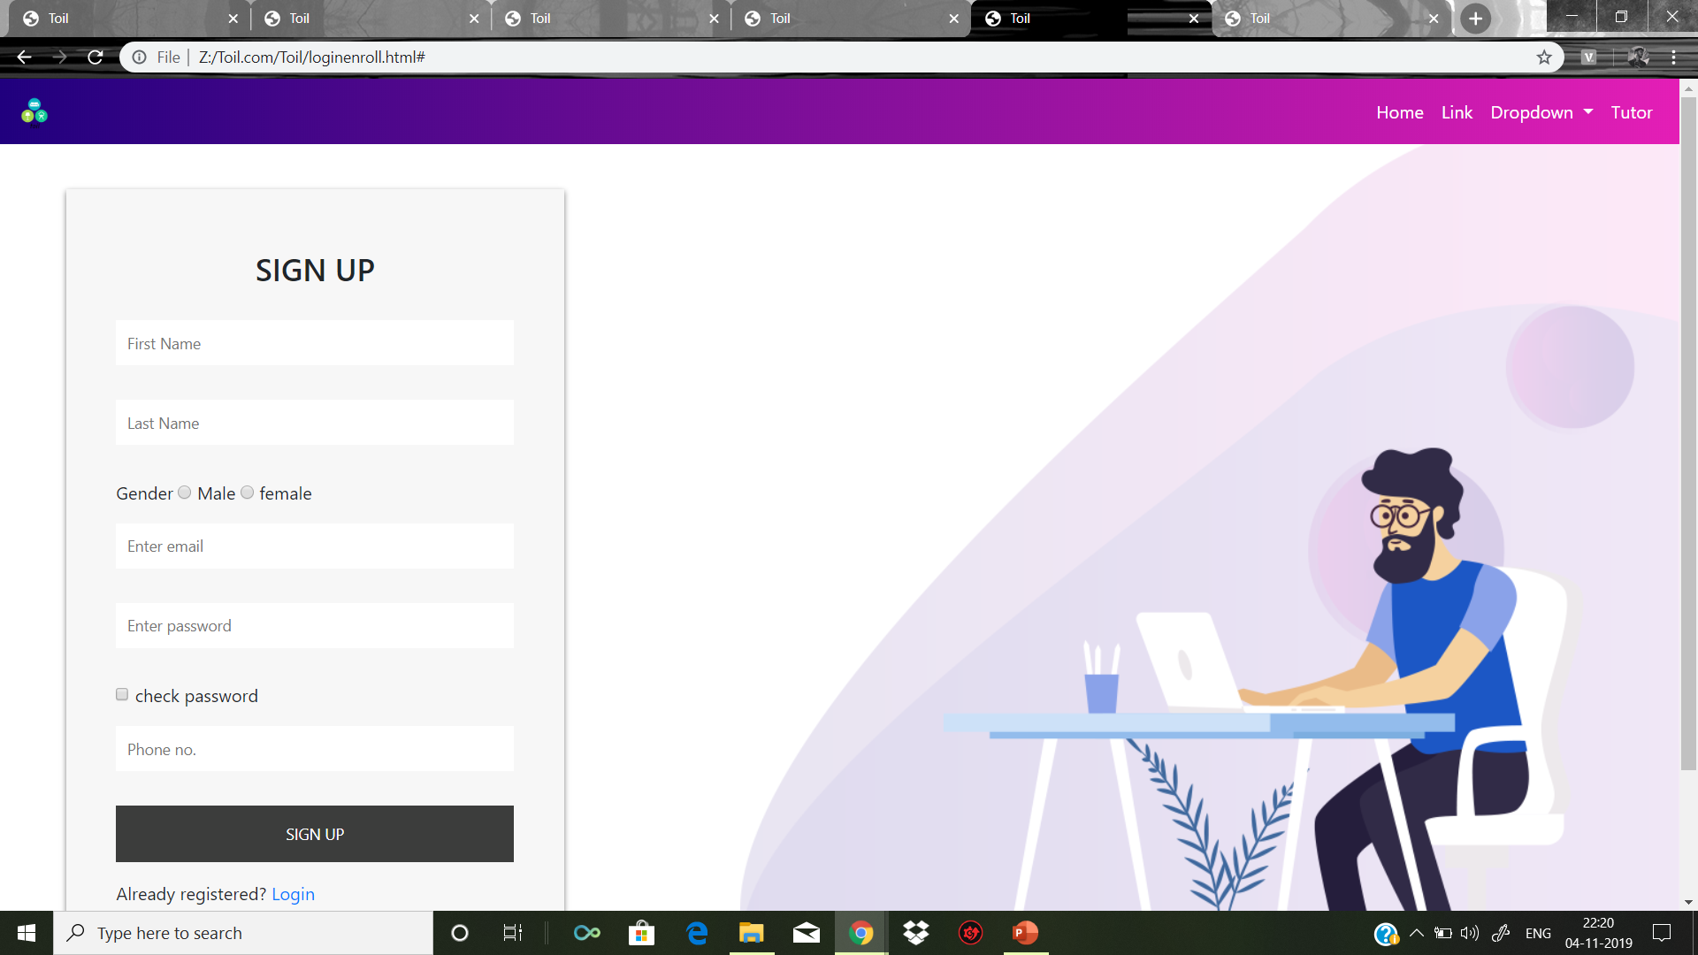

Slide 24
SWOT ANALYSIS AND CONCLUSION OF THE PROJECT
Strengths (internal factors)
User friendly
Attractive user interface
Motivation for blood donors
Create awareness
An interface for needy peoply
Opportunities (external factors)
Technology and infrastructure development
To increase the awareness
A third party system between doctors and patients
Weaknesses (internal factors)
No database
No start rating
Doctor contact
Emergency contacts
Doctor-patients discussion forum
Threats (external factors)
Website Crash
Database Crash
Data leakage
Webserver hacking

Slide 25
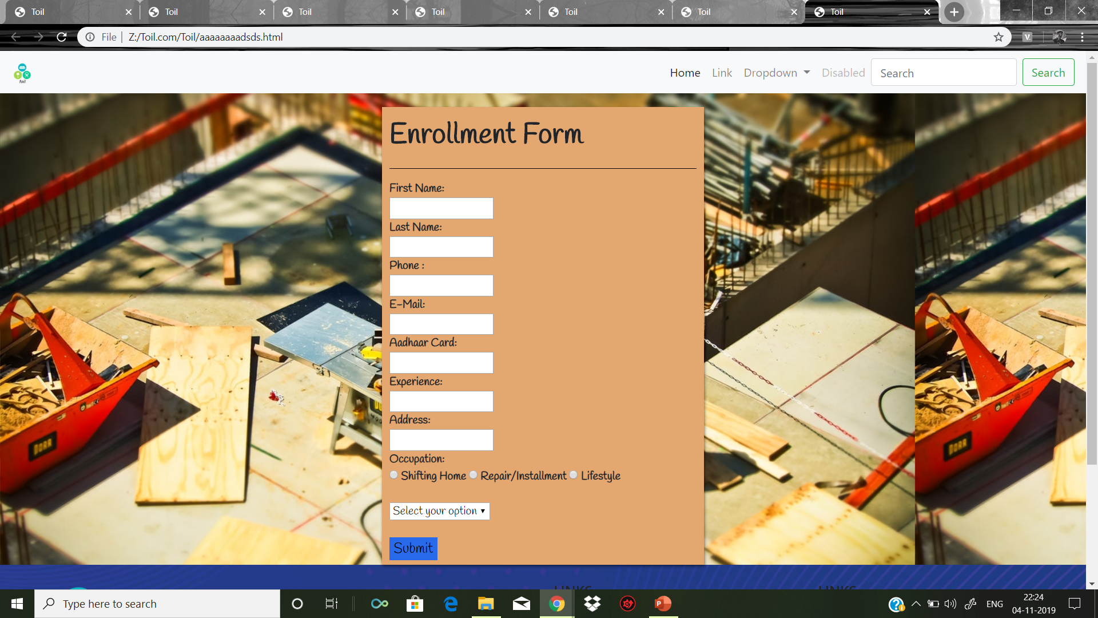
Candidate 3: Abhishek Hatwar registration form at enrolment side

Slide 26
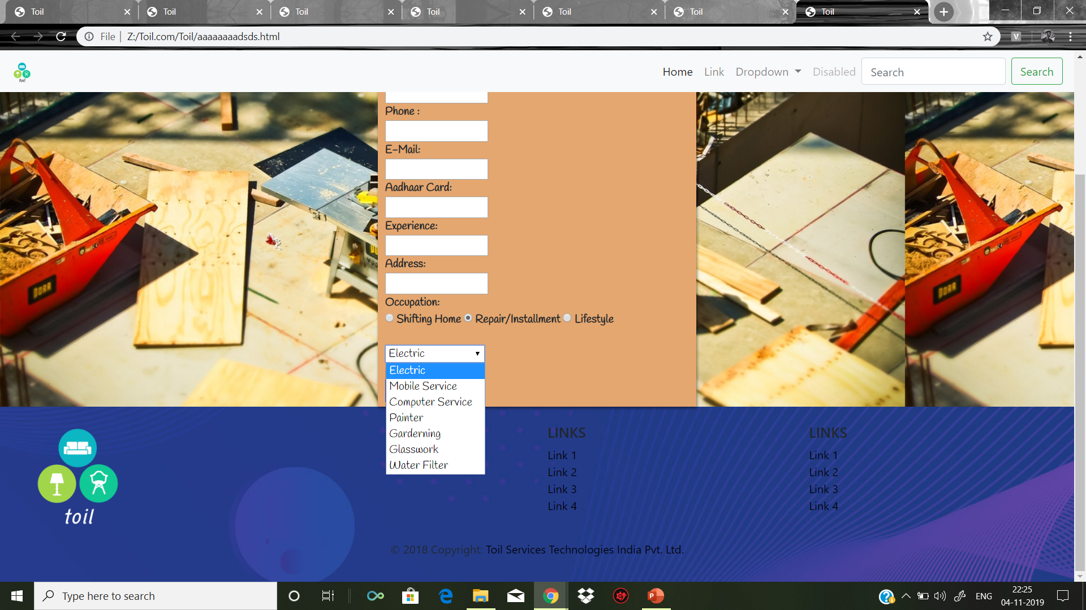

Slide 27


Slide 29
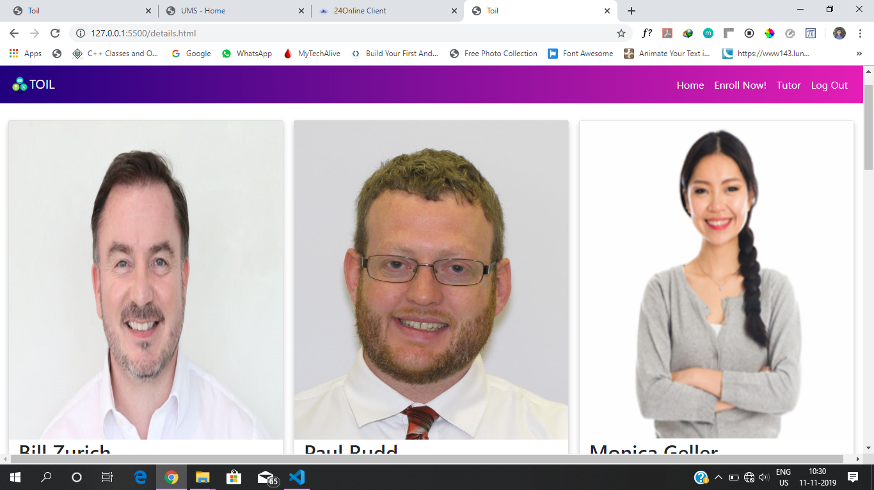
Aman Srivastav

Slide 30
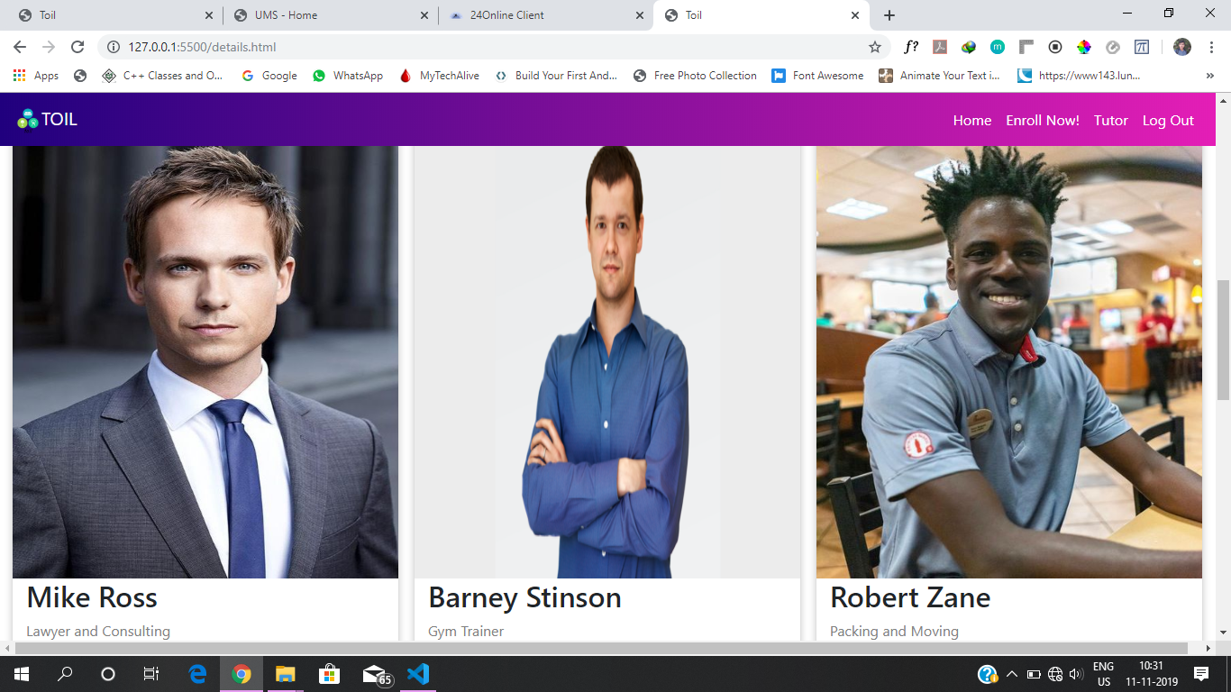

Slide 31
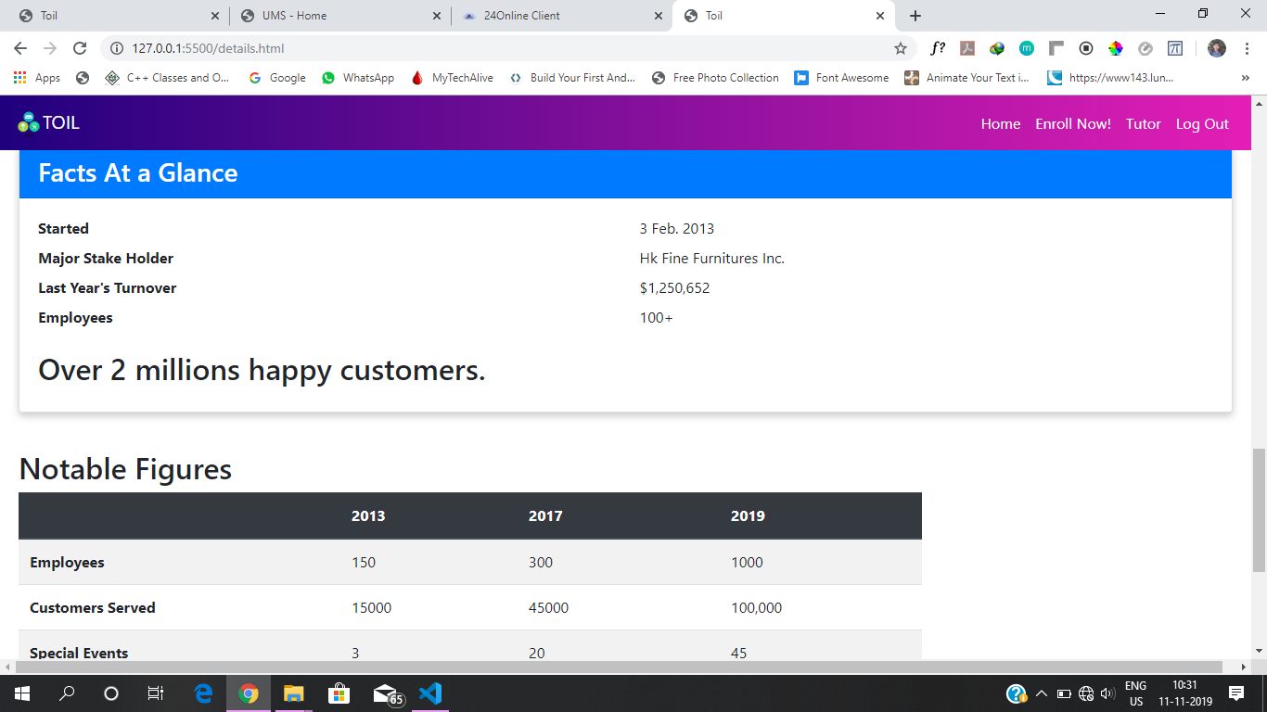

Slide 32
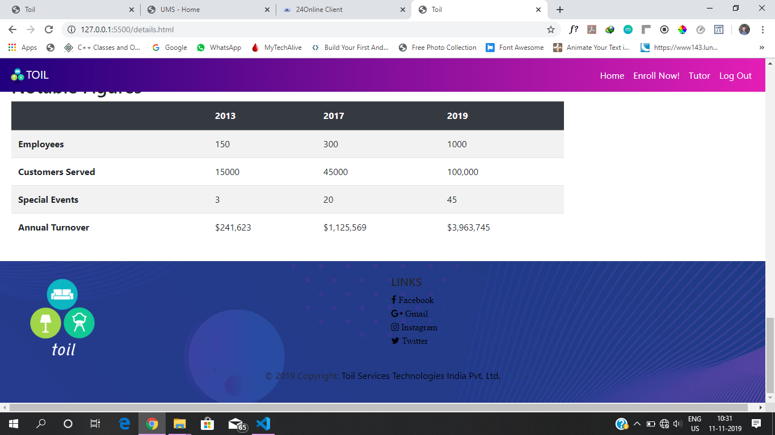

Slide 33
Thank you

